Slide 1



User Interface (Android App)
User Submits:
Photo of Lost/Found Dog
Location (ex: long/lat)
Contact Info (ex: email)
Save:
Original image of dog
Contact Info
Location
Notify the user of the top N matches (if/when available)
Model 1: Dog Detector
Create box around dog, and extract
Save:
Save extracted image
Back End
Model 2: Breed Classification
Determine the top K breeds
Save:
Breed Classification
Dog Comparisons
Model 3: Dog Identification
Compare the “lost” dog with the “found” dogs (or “found” with “lost) that fall within the K top breed classification of the “lost” dog and are within X distance of where the dog was lost.

Slide 2

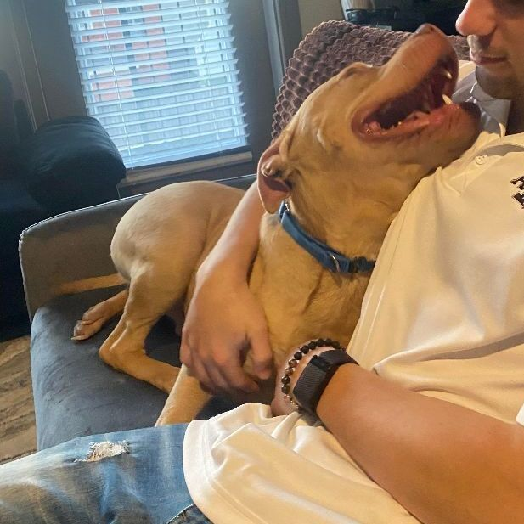
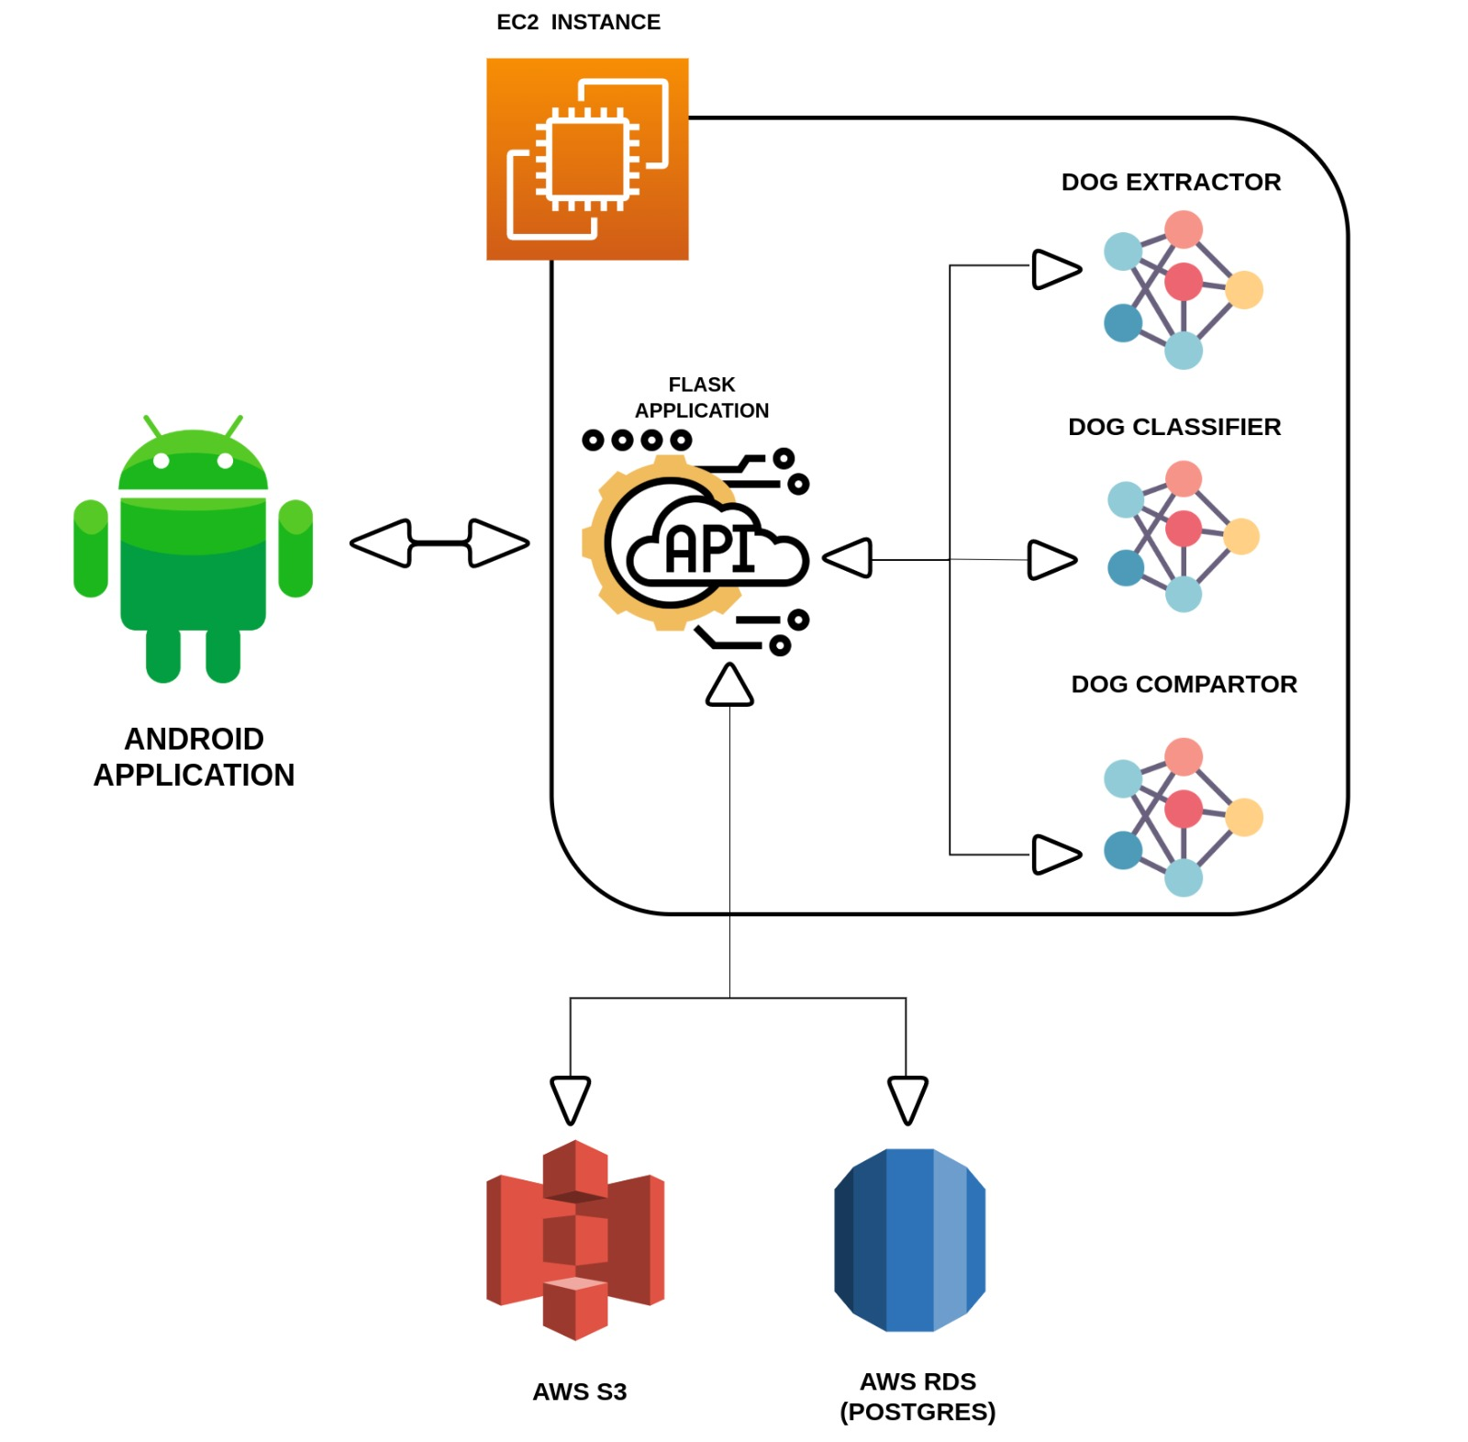
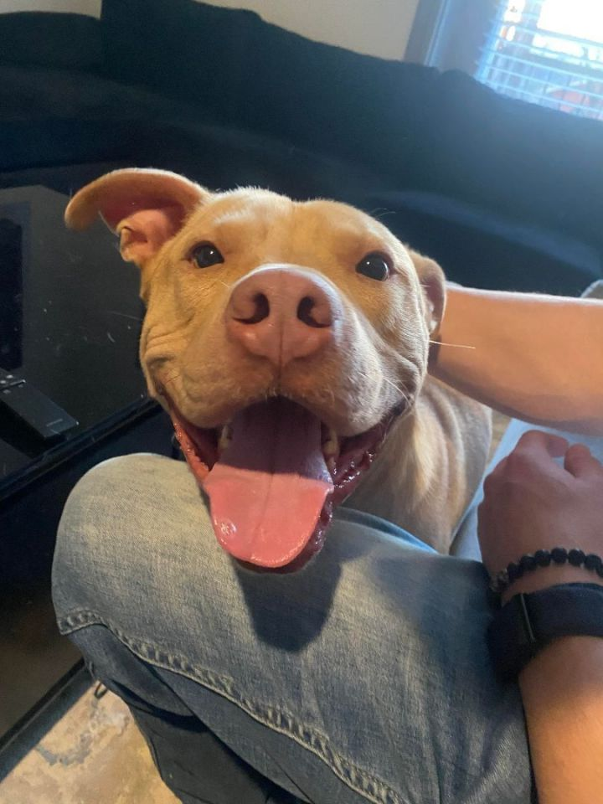
DOG EXTRACTOR
DOG CLASSIFIER
DOG COMPARATOR
LOST DOG
TOP K BREEDS CLASSIFICATION
COMPARE USING TOP K BREEDS AND LOCATION AS FILTERS
EX OUTPUT: 0.65
RETURN TOP N RESULTS
FOUND DOG
TOP K BREEDS CLASSIFICATION

Slide 3
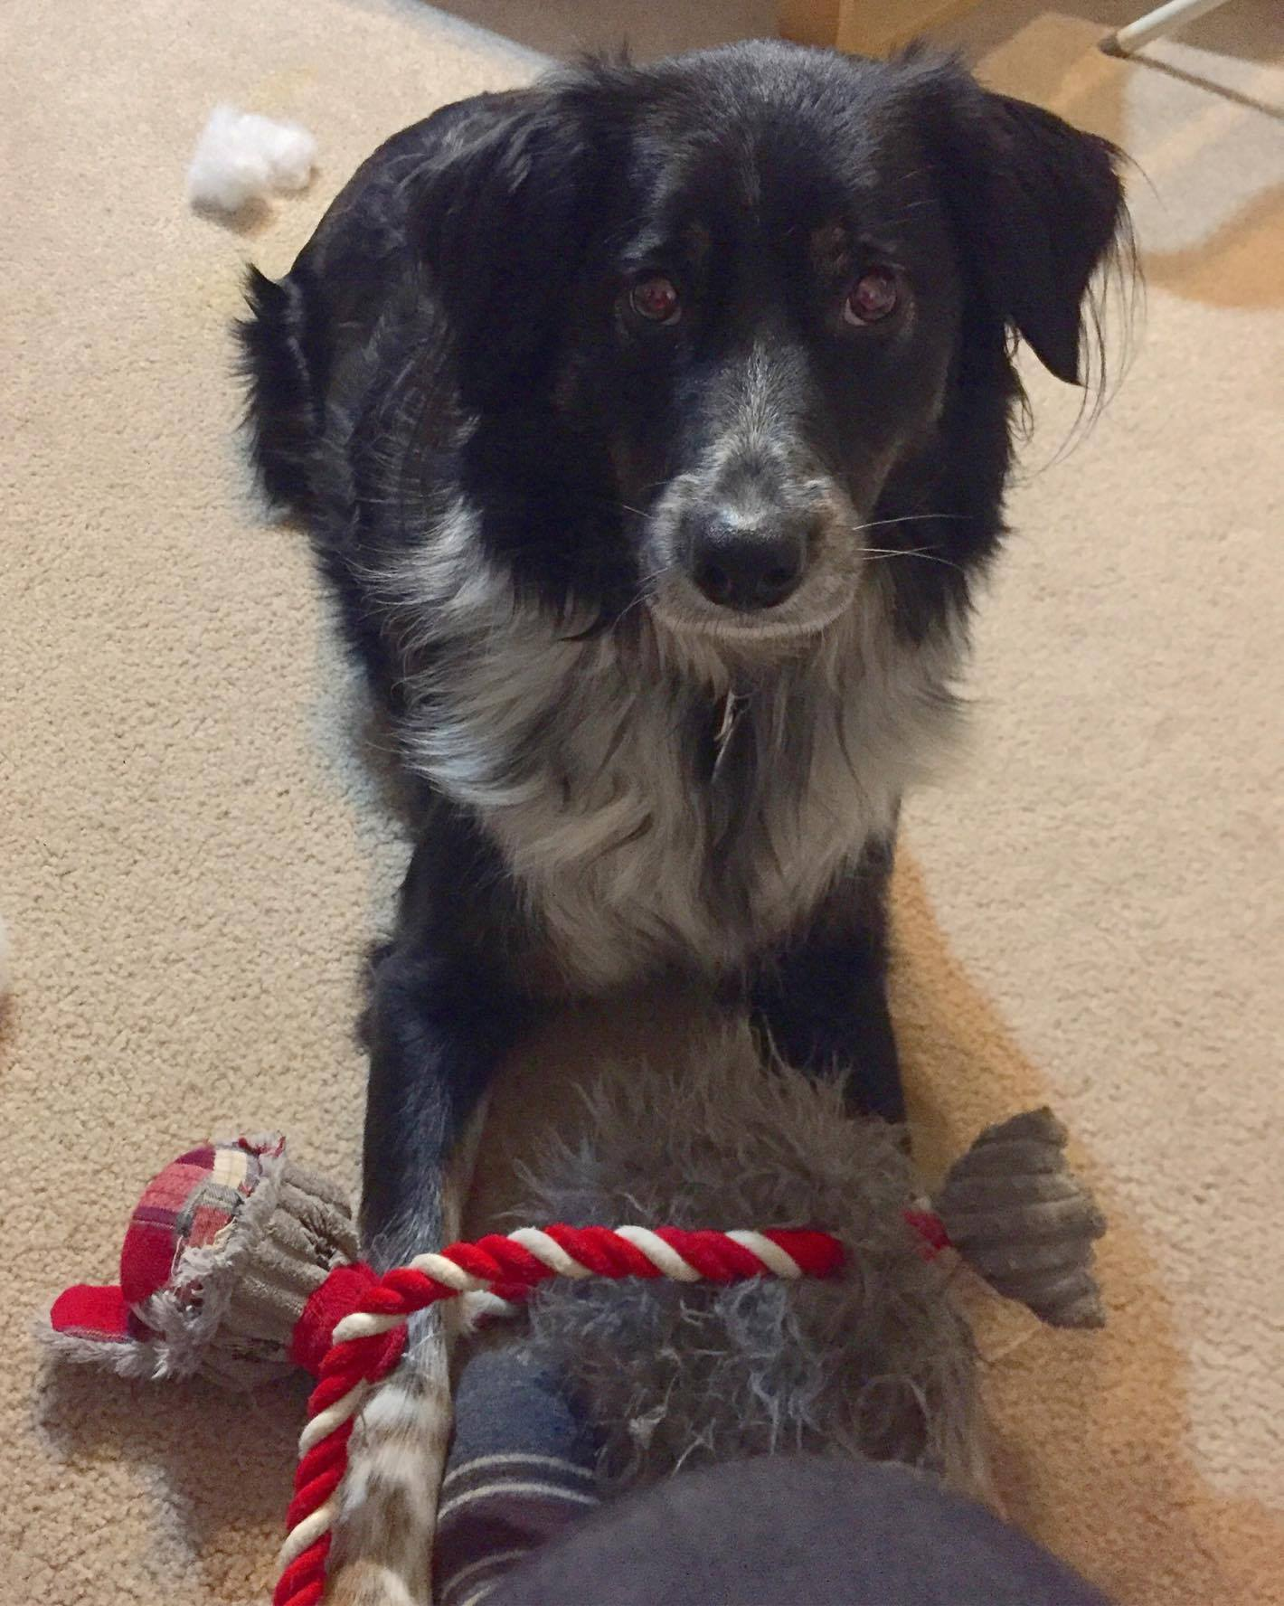
LOST DOG
Charlie
Call: (604) 354-1234

Slide 4
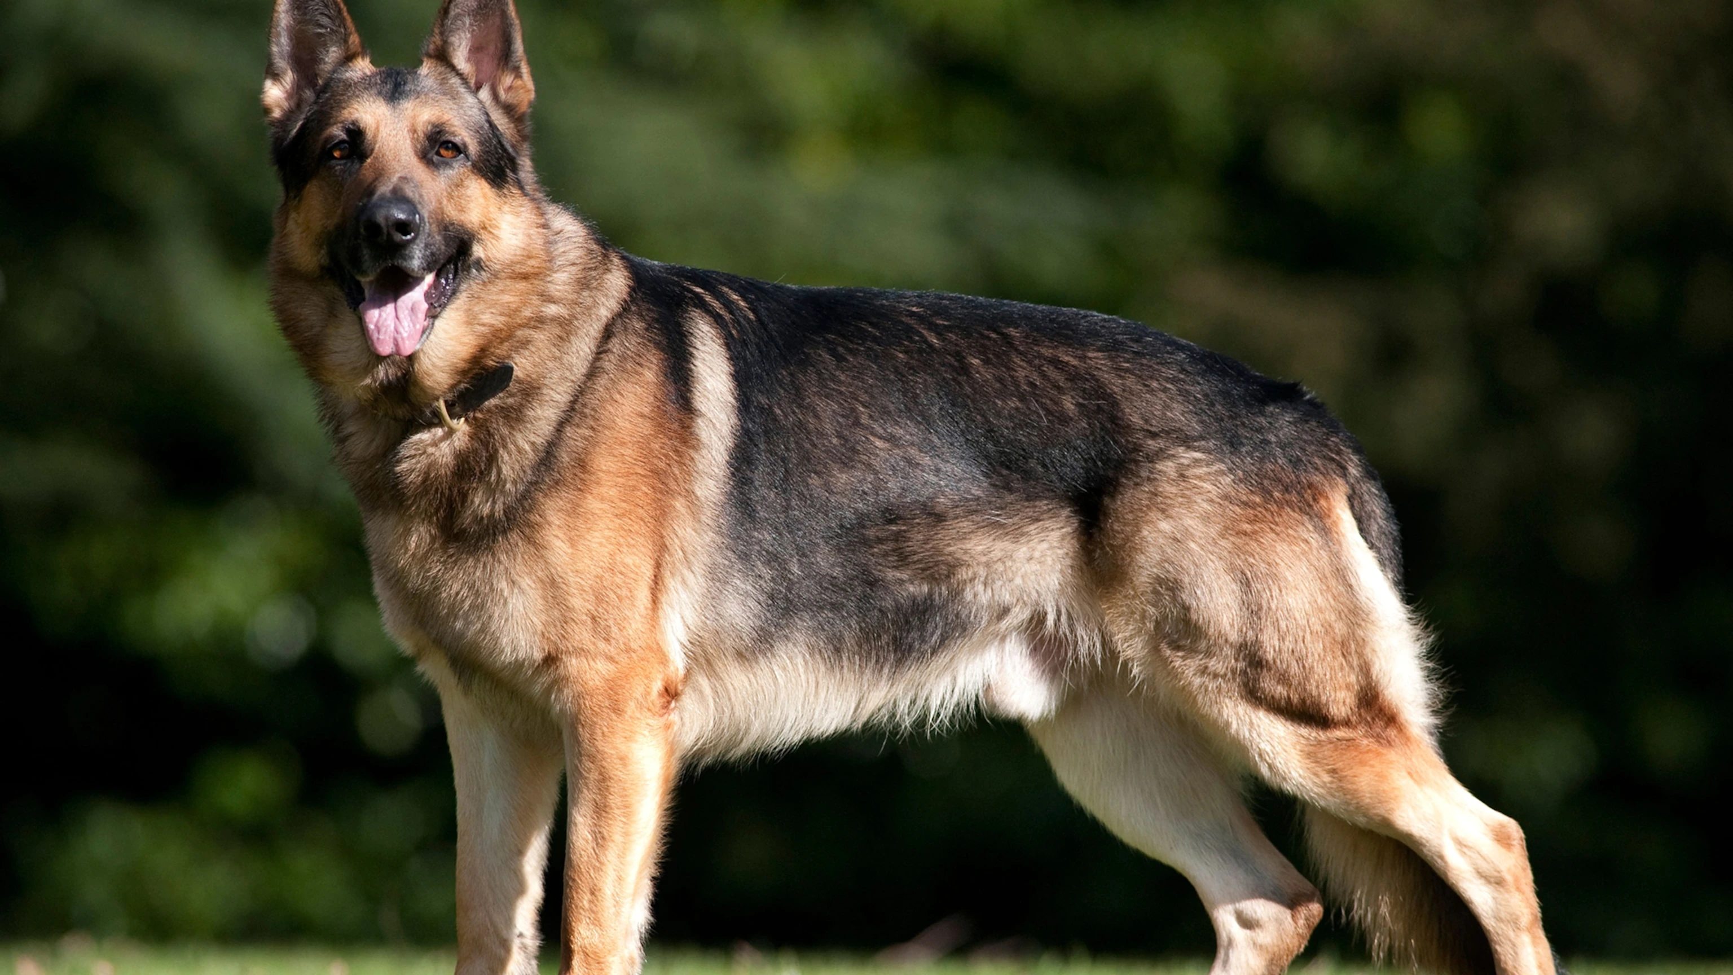
https://www.nationalgeographic.com/animals/article/first-dog-to-test-positive-in-us-for-coronavirus

Slide 5
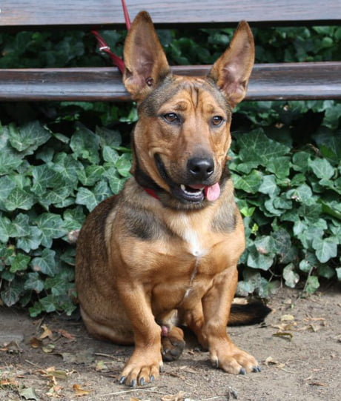
https://www.nationalgeographic.com/animals/article/first-dog-to-test-positive-in-us-for-coronavirus

Slide 6
https://img-9gag-fun.9cache.com/photo/aBwEjbZ_460s.jpg

Slide 7
https://img-9gag-fun.9cache.com/photo/aBwEjbZ_460s.jpg

Slide 8
https://img-9gag-fun.9cache.com/photo/aBwEjbZ_460s.jpg

Slide 9
DOG DATA RECORDED
Contact Information
Bounding Box
Location
RECORD TOP K BREEDS
QUERY ENCODINGS OF FOUND DOGS BY LOCATION & BREED
DOG EXTRACTOR
DOG CLASSIFIER
DOG COMPARATOR
USER SUBMITS LOST DOG
TOP K BREEDS CLASSIFICATION
?
RETURN TOP N RESULTS
SAVE ORIGINAL UNCROPPED IMAGE

Slide 10
DOG DATA RECORDED
Contact Information
Bounding Box
Location
RECORD TOP
QUERY ENCODINGS OF FOUND DOGS BY LOCATION & BREED
USER SUBMITS LOST DOG
DOG EXTRACTOR
DOG CLASSIFIER
DOG COMPARATOR
TOP BREED CLASSIFICATION
?
RETURN TOP N RESULTS
SAVE ORIGINAL UNCROPPED IMAGE

Slide 12
